Slide 1
Web Scraping
Archak Amruth
Pushkar Chauhan
Dhiraj Suthar

Slide 2
Content
What is Web Scraping ?
Whats is Selenium ?
Webdriver Architecture
Webdriver Components
Demo
Whats is Scrapy ?
Architecture
Components
Demo
Differences

Slide 3
What is
WEB SCRAPING ?
Extracting data from websites.
Most of data is unstructured data in an HTML format which is then converted into structured data in a spreadsheet or a database
Methods used for scraping
HTTP Client
a web browser

Slide 4

What is SELENIUM ?
Functional Automation tool for web applications.
open source tool.
Supports languages like java, python, ruby & c#.
Supports all the key vendors of the browser like Firefox, Safari, Chrome, Opera, etc.
It is very flexible when compared to QTP and other tools, because it supports multiple languages.
Use cases:
Automation
Scraping
Testing
Notes:
For this training we will be using Chrome
There are other way to do scraping: web_driver, remote_control, grid.
Here, we will be using webdriver.

Slide 5
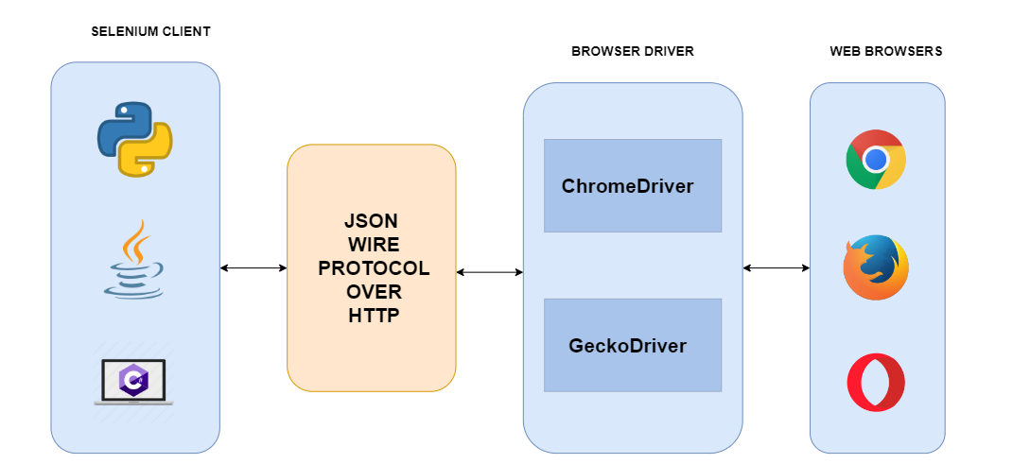
Selenium WebDriver Architecture

Slide 6
Selenium WebDriver Components
Selenium Client (with Language Bindings) | Selenium uses many client drivers with specific language binding such as java, python, ruby. so to work with each programming language there is a different client driver.
JSON Wire Protocol | provides a transport mechanism to transfer data between a server and a client.
Browser Drivers | Selenium uses drivers, specific to each browser in order to establish a secure connection with the browser without revealing the internal logic of browser's functionality.
Browsers | Microsoft Edge, Mozilla Firefox, Google Chrome, Safari

Slide 7
Selenium Demo
https://github.com/dileep-gadiraju/python-webscraping-quickstart

Slide 8
Q&A

Slide 9

What is SCRAPY ?
free and open-source web-crawling framework written in Python
also can be used to extract data using APIs or as a general-purpose web crawler
follows don't repeat yourself frameworks, such as Django
easier to build and scale large crawling projects
also provides a web-crawling shell, which can be used by developers to test their assumptions on a site’s behavior.
powerful features provided such as :
Auto-throttle
rotating proxies
User-agents
Notes:
Feature:- Web crawling shell.

Slide 10
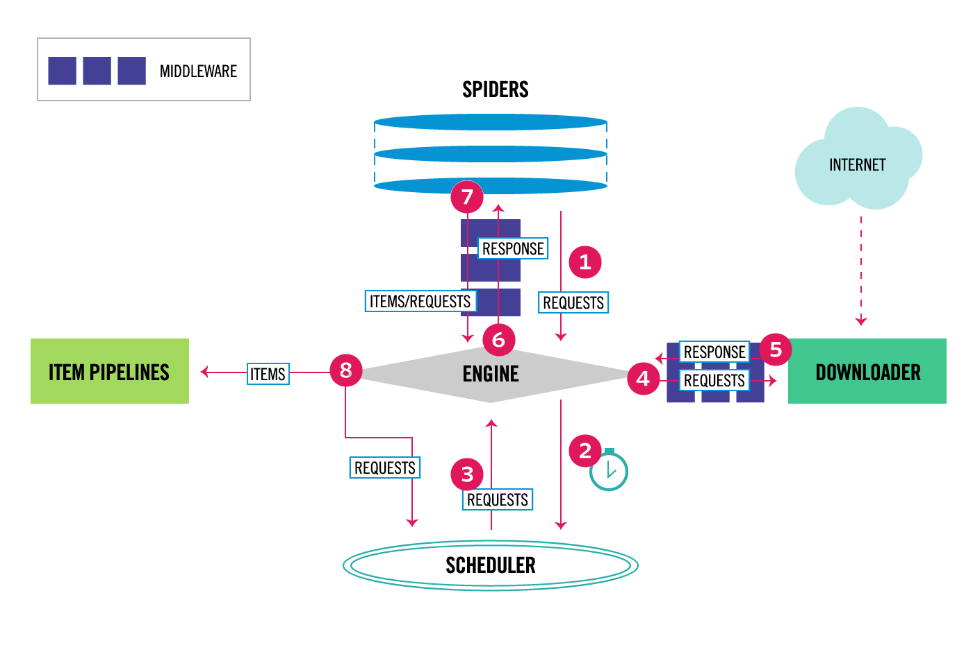
Scrapy Architecture

Slide 11
Components
Scrapy Engine | is responsible for controlling the data flow between all components of the system, and triggering events.
Scheduler | receives requests from the engine and enqueues them for feeding them later.
Downloader | is responsible for fetching web pages and feeding them to the engine.
Spiders | are custom classes written users to parse responses and extract items from them.
Item Pipeline | is responsible for processing the items once they have been extracted (cleansing, validation and persistence)

Slide 12
Components
Downloader middlewares | are specific hooks that sit between the Engine and the Downloader and process requests. Use a Downloader middleware if you need to: 1.process a request just before it is sent to the Downloader. 2.change received response before passing it to a spider 3.silently drop some requests
Spider middlewares | are able to process spider input (responses) and output (items and requests). Use a Spider middleware if you need to: 1.post-process output of spider 2.post-process start_requests

Slide 13
Scrapy Demo
https://github.com/dileep-gadiraju/python-webscraping-quickstart

Slide 14
SELENIUM vs SCRAPY vs BSOUP
CRITERIA | BEAUTIFULSOUP | SELENIUM | SCRAPY
speed | Medium (fast if multithreaded) | medium | fast
memory/CPU | low | high | low
Extensibility | low | low | high
debugging | difficult | easy | medium
login | complex | easy | complex
JS support | False | True | False
web-support | static | dynamic+static | static

Slide 15
Q&A

Slide 16
Thank you!

